Slide 1
Entertainment Hub
API Project
Merging musical and cinematic entertainment

Slide 2

Elevator Pitch
Movies/TV Shows
Search
Music
The user will have access to a huge database of movie info.
The user interacts with this website primarily through search
The user will have access to a huge database of music info.

Slide 3
Processing
Proposal
Development
Webpage Sneakpeak
Future Iterations
To connect movies to their musical soundtracks
With the use of a music and movie api we bridge the connection
Entertainment Hub allows users to search for soundtracks of their favorite movies
The user will have greater access to album and composer information

Slide 4
About the Project
Bettering the user interaction for movies by increasing the accessibility of the soundtrack
We utilized Tailwind for cleaner visuals.
Use at minimum two APIs that the user can interact with.
Prove our concept by displaying data received.
Music and cinematic entertainment all in one place!

Slide 5


Concept
Spotify
The Movie DB
Movie
&
TV Show API
Album/Music API

Slide 6
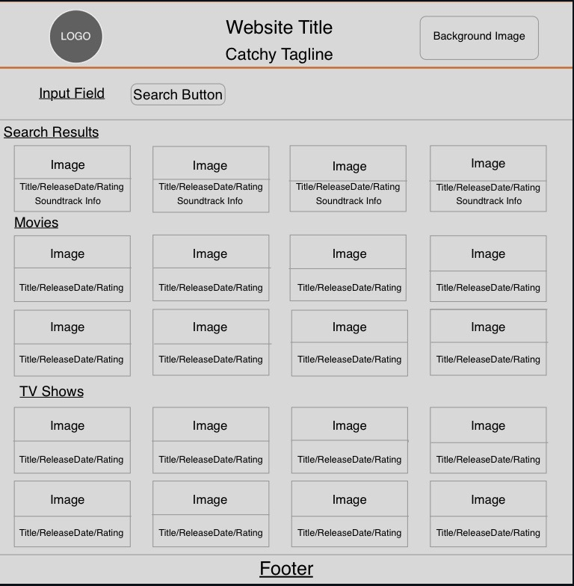

Wireframe

Slide 7

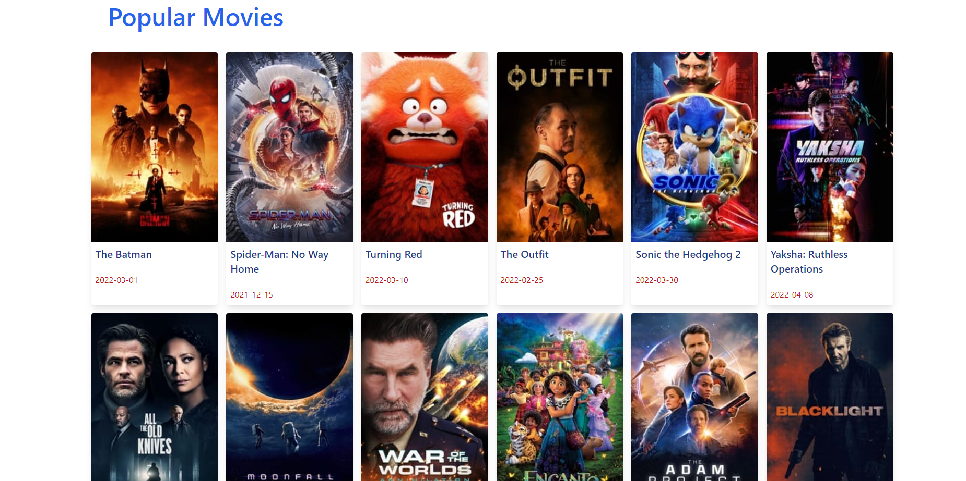
Webpage Sneakpeak

Slide 8

Demo

Slide 9
Trials & Tribulations
Challenges
Successes
Getting access to the Spotify API, more complex compared to the movie API
Displaying data of the music with the movie
Regrouping as a team
Learning how to obtain the key from more complex APIs
Getting more comfortable with APIs and understanding various functions
Integrating minor Tailwind to help streamline the format

Slide 10
Past, Present, Future
Proposal
Present
Development
Future
Users can see more composer information side by side with movie info
Merge Spotify and movie DB to create a search based app
Create an app much like Netflix with musical aspects
Users can interact with both cinematic & music APIs

Slide 11
Team Members
Zhunn Altmark
Jonathan Clark
Leelai Hayslett
Hasnain Khalfan
Sydnee Peebles

Slide 12
THANKS!
Questions?
Deployed:
https://hkhalfan1979.github.io/entertainment-hub/
Github Repo:
https://github.com/hkhalfan1979/entertainment-hub/blob/hasnain/assets/js/script.js

Slide 13
RESOURCES
Clean Visuals:
Tailwind
Special Thanks:
Anthony Maddatu

